Slide 1
Recent Advances in Multiobjective Evolutionary Algorithms
Voratas Kachitvichyanukul
School of Engineering and Technology Asian Institute of Technology, Thailand voratas@ait.ac.th
Zhejiang University
November 17, 2014

Slide 2
Polynomial versus NP-Hard

Slide 3
Evolutionary Algorithm (EA)
Sometime also called
evolutionary computation (EC) or
evolutionary intelligence (EI).
Strength
free from model structure
Weakness
do not know when the best answer is found

Slide 4
Where EA fits
Multiobjective optimization
Multimodal optimization
Constrained optimization
Combinatorial optimization
Artificial Intelligence
Engineering
Operations Research
EA

Slide 5
Examples of EA
Genetic Algorithm
Particle Swarm Optimization
Differential Evolution
Artificial Immune System
Ant Colony ?
Bee Colony ?
…

Slide 6
What do they have in common?
Three main characteristics
Population based
Fitness driven
Variation driven

Slide 7
Multi-objective (MO) problems
Important in many applications
Traditional optimization approaches try to simplify MO by combining all objective function into a single objective function
More easily to attack with available methods
Requiring the preference of decision makers prior to the optimization process
Pareto optimization currently attracts more attention and Meta-heuristics are commonly applied to find Pareto front

Slide 8
Multi-Objective
Conflicting
Hierarchical
Multiple decision makers with partial control of decision variables
Involve trade-offs of one objective against the others
No single solution

Slide 9
For minimization problem

Slide 10
Pareto Optimality
f₂
y
f₂(y)
x
f₂(x)
Pareto frontier
Non- dominated front
f₁
f₁(x)
f₁(y)
Notes:
Let me explain the concept of Pareto front , this figure show an example of two objective function f1 and f2 with minimization problem. The dots represents a solution with respect to their fitness value f1 and f2.
In this graph, we can see that “the solution X dominates solution y” or “x is better than y” because the objective function of f1 and f2 are less than both in y.
So, what we want is a non-dominated front which consists of a set solution which are non-dominated by other solution on that front .

Slide 11
Comparing Pareto Fronts
f₂
Pareto frontier 2
Pareto frontier 1
f₁
Notes:
Let me explain the concept of Pareto front , this figure show an example of two objective function f1 and f2 with minimization problem. The dots represents a solution with respect to their fitness value f1 and f2.
In this graph, we can see that “the solution X dominates solution y” or “x is better than y” because the objective function of f1 and f2 are less than both in y.
So, what we want is a non-dominated front which consists of a set solution which are non-dominated by other solution on that front .

Slide 12
Metrics
Inverted Generational Distance (IGD)
SPREAD

Slide 13
MOGA
Fonseca and Fleming (1993)
Use k+1 populations of chromosomes
The each population optimize one of the k objectives
The k+1 population optimize the combined objective
the fitness value is determined based on the number of solutions that dominate it

Slide 14
NSGA
Srinivas and Deb (1994) proposed Non-dominated Sorting Genetic Algorithm (NSGA) to assigned fitness values based on Pareto ranking
Both MOGA and NSGA applied the concept of fitness sharing which intends to degrade the fitness of an individual according to its density in the neighborhood area

Slide 15
MOPSO
Particle Swarm Optimization – PSO – is a powerful evolutionary methods
PSO allows particles in the swarm to fly in a very large searching space
Suitable for exploring Pareto fronts
Research questions:
How to efficiently use PSO framework to solve MO problems ?
What movement strategy should be used to obtain quality Pareto fronts ?

Slide 16
PSO Framework for Single objective
Start
Initialize particles with random position and zero velocity
Evaluate Objective Values
Update pBest & gBest
Meet stopping criterion?
Yes
End
No
Update velocity and position

Slide 17
PSO Framework for Multi-objective
Start
Initialize particles with random position and zero velocity
Evaluate Objective Values
Elite group
Determine global
non-dominated front
Yes
End
Meet stopping criterion?
No
Update guidance
Update velocity and position

Slide 18
Movement Strategies
f₂
Non- dominated front
f₁
Notes:
Let me explain the concept of Pareto front , this figure show an example of two objective function f1 and f2 with minimization problem. The dots represents a solution with respect to their fitness value f1 and f2.
In this graph, we can see that “the solution X dominates solution y” or “x is better than y” because the objective function of f1 and f2 are less than both in y.
So, what we want is a non-dominated front which consists of a set solution which are non-dominated by other solution on that front .

Slide 19
Movement strategies
Because a single global best does not make any sense in multi-objective problem, a new representative for the global knowledge of the swarm need to be redefined based on the movement strategy.

Slide 20
Movement Strategies
There are endless possibilities
Brute force, simply did whatever the original PSO did in single objective
Random Walk
Explore the unexplored space in the non-dominated front
Filling the gap between solutions in the existing non-dominated front

Slide 21
Movement strategies Explored
Ms0: Particles only use local information
Ms1: Pick a global guidance located in the least crowded areas
Ms2: Explore the unexplored space in the non-dominated front
Ms3: Explore the boundaries of the non-dominated front
Ms*: Explore solution space with mixed particles

Slide 22
Crowding Distance (CD)
f₂
Less crowded
Elite group
f₁

Slide 23
Ms1: Pick a global guidance located in the least crowded areas
A scalar called crowding distance (CD) will be calculated for each particle in the Elite group
The particle should move to less crowded area
f₂
More attractive
Elite group
f₁

Slide 24
Ms2: Explore the unexplored space in the non-dominated front
In general, particles tend to converge to good areas which may form clusters of particles near the front.
Particles need to be guided to potential unexplored area of the front.
f₂
Current Position
E₂-P_{i}
E₁-E₂
Elite group
E₂
P_{i}
E₁
f₁

Slide 25
Ms3: Explore the Boundaries of the non-dominated front
Particles need to be guided toward the top or bottom end of the non-dominated front.
More attractive
f₂
More attractive
Elite group
f₁

Slide 26
Ms*: Explore the space with mixed particles
A productive swarm should have following groups of members:
Ones that prefer to explore based on its own local non-dominated position (Ms0)
Ones that prefer to follow the global trend but avoid the crowded areas–(Ms1)
Ones that fill the gaps left by previous movements– Group 2 (Ms2)
Ones that like to explore new areas– Group 3 (Ms3)

Slide 27
Metrics
Inverted Generational Distance (IGD)
SPREAD

Slide 28
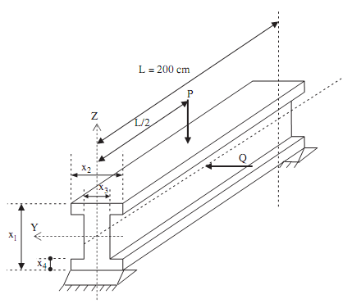
I-Beam Design Problem

Slide 29
I-Beam Design Problem
This is a non-linear design problem to find the dimension of an I-beam as shown in earlier slide, which must satisfy the geometric and strength constraints and minimize following objective functions:
Cross section area of beam
Static deflection of the beam under a certain force

Slide 30
Mathematical Model
Coello and Christiansen (1999)

Slide 31
Pareto for the I-Beam Design

Slide 32
Limited Assets Markowitz model

Slide 33
Pareto Front

Slide 34
Computational Time
Data Set | Number Assets | K=5
 |  | CPLEX | INC. SET | PSO-Ms1 | PSO-Ms2 | PSO-Ms*
Hang Seng | 31 | 12 | 39 | 3 | 2 | 2
DAX 100 | 85 | 906 | 363 | 3 | 2 | 3
FTSE 100 | 89 | 3190 | 638 | 3 | 2 | 3
S&P 100 | 98 | 12055 | 1363 | 3 | 2 | 3
Nikkei | 225 | 186 | 389 | 18 | 16 | 18
S&P 500 | 457 | - | 2625 | 31 | 26 | 26
Russell 2000 | 1318 | - | 14819 | 73 | 72 | 74
Russell 3000 | 2151 | - | 47964 | 120 | 117 | 121

Slide 35
Summary (1)
The PSO algorithm with multiple movement strategies, PSO-Ms*, has shown the most robust results and outperformed NSGA-II and NSGA-II with self adaptive mechanism in both quality of the non-dominated solutions and the spread of these solutions

Slide 36
Summary (2)
Two real-world applications are also used to confirm the effectiveness of multi-objective PSO algorithms. In the engineering design problem, the solutions found by PSO-Ms* are very competitive with other algorithms in literature. Besides, it is also noted that the PSO algorithms can be easily modified to handle constraints.

Slide 37
Summary (3)
The portfolio optimization problem demonstrated that the algorithm is very efficient even when dealing with problems that require indirect encoding/decoding procedure. Moreover, the PSO algorithms are also very robust when tested with high dimensional problems

Slide 38

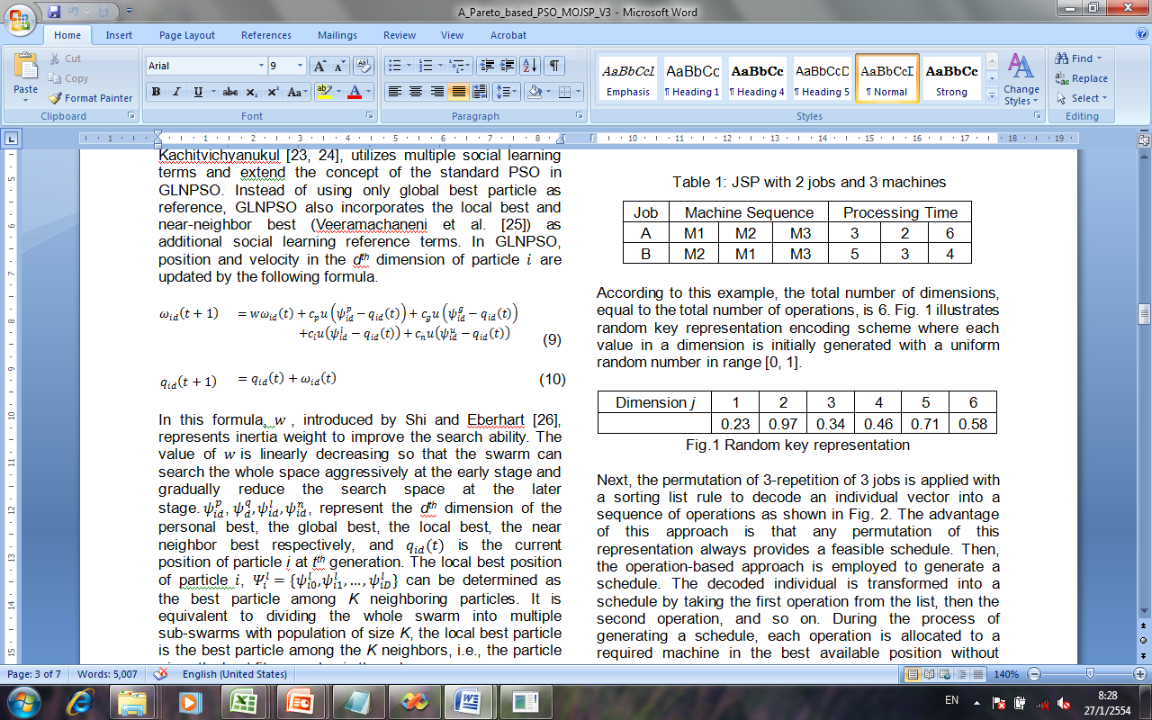
GLNPSO
This study implements GLNPSO (Pongchairerk and Kachitvichyanukul 2005) with the use of multiple social learning terms
GLNPSO : Global, Local and , Near-Neighbor Particle Swarm Optimization
Notes:
Actually, there are many version of PSO proposed by researchers.
In this study, we applied GLNPSO which was proposed by Pongchairerk and Kachitvichyanukul in 2005.
Instead of using only one global learning term , GLNPSO uses multiple social learning terms which are global, local , and near-neighbor to help the particles to gain more knowledge and increase the coverage of the search space.

Slide 39
Solution Mapping
Encoding
Apply a random key representation (Bean, 1994) which always generate a feasible schedule
number of dimensions = total number of operations
JSP : 2 jobs 3 machine
Job | Machine Sequence |  |  | Processing Time
A | M1 | M2 | M3 | 3 | 2 | 6
B | M2 | M1 | M3 | 5 | 3 | 4
Dim.
1
2
3
4
5
6
.23
.97
.34
.46
.71
.58
Notes:
So, how we mapped the solution for JSP,
First, we use random key representation to encode solution; the number of dimensions is set to be equal to the total number of operations. With an example of 2 jobs 3 machines; total operations is 6. Then we have the total dimension of 6, and each value in a vector dimension is initially generated with a uniform random number in range [0, 1].

Slide 40
Solution Mapping
Apply the m-repetition of job numbers permutation (Tasgetiren et al., 2005)
Dim.
1
2
3
4
5
6
.23
.97
.34
.46
.71
.58
Dim.
1
3
4
6
5
2
.23
.34
.46
.58
.71
.97
Dim.
1
3
4
6
5
2
A
A
A
B
B
B
Dim.
1
2
3
4
5
6
A
B
A
A
B
B
Notes:
Then, we apply m-repetition of job numbers permutation to determine sequence of operations. Suppose that each dimension have value like this. These values are sorted by ascending order. Then, the repetition of job number will be assigned to these dimensions based on the number of operations. In these example, Both Job A and Job B have three operations, so the first three dimensions will be assigned to Job A, and the next three dimensions will be assign to job B.
Finally, the dimension is re-order as original order to determine the sequence of all operations.

Slide 41
Solution Mapping
Decoding
Apply operation-based approach (Cheng et al.,1996) to generate an active schedule
Job | Machine Sequence |  |  | Processing Time
A | M1 | M2 | M3 | 3 | 2 | 6
B | M2 | M1 | M3 | 5 | 3 | 4
Dim.
1
2
3
4
5
6
A
B
A
A
B
B
M1
A
B
M2
B
A
M3
A
B
2
4
6
8
10
12
14
16
18
Notes:
To decode solution in to a schedule, we apply operation-based approach which always generates an active schedule.
Note that when we see Job A for the first time, it means the first operation of job A, when we see the job A for the second time; it means the second operation of Job A. So, the first operation of job A on M1 with processing time 3, will be schedule first. Then the first operation of Job B, on M2 with processing time 5 will be scheduled, and then second operation of job A on M2, and so on … Finally we will get the completed schedule.

Slide 42
Multi-objective PSO (MOPSO)
Start
Initialize particle with random position and zero velocity
Evaluate Objective values
Elite group
Determine global non-dominated front
Meet Stopping Criteria
Yes
End
No
Update guidance
Update velocity and position
Notes:
This study use MOPSO algorithm proposed by Su and Prof. Voratas.
In this framework, most of procedures are similar to a basic PSO, but with an addition of Elite group which store a set of non-dominated solutions found by the whole swarm.
Then the solutions in Elite group will be selected to guide the movement of the swarm.
Therefore another important aspect is the movement strategy of particles to search for a better set of non-dominated solutions

Slide 43
Movement Strategy
This study adopts Ms* strategy in MOPSO
Swarm
Global Knowledge
Personal Knowledge
Group1
Group2
Group3
Group4
Less crowed area
Gaps
Borders
Elite
Group
Notes:
This study applies Ms* strategy in MOPSO , which have been successfully applied to solve many test problems.
The Ms* uses a single swarm with a mixture of particles with different movement behaviors.
G 1 will search based on its own experience, G2, G3 and G4 uitlize global knowledge to lead their move.
G1 aims to search at the less crowded area, G2 try to fill the gaps of solutions on Pareto-front, and G4 aim to search at the border of the front
The four group of particles corporate in the same swarm, sharing their flying experience, and store the knowledge in the common Elite group.

Slide 44
Computational Experiment
Objective : Minimize makespan and
Minimize total tardiness of jobs
Test Instance
FT06, FT10, FT20, ABZ5, ABZ6, LA26, LA27, LA28
Parameter Setting
Inertia weight | Linearly decrease from 0.9 to 0.4
Constant acceleration | C_{p} , C_{g} , C_{l} , C_{n} = 1
Swarm size | 1200 particles (400 each group)
Particles in Elite group | 100 particles
% top members | 10
% bottom members | 20
% Potential gap | 5
Number of iterations | 2000
Number of replications | 5
Notes:
The objective is to find schedule which minimize makespan and total tardiness of jobs simultaneously
We use eight instances from benchmark JSP.
The parameter used in shown in this table

Slide 45
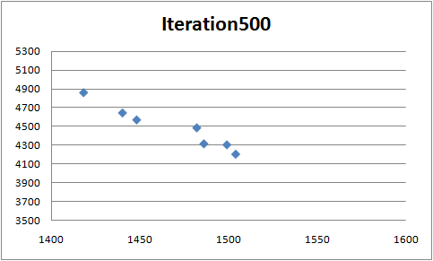
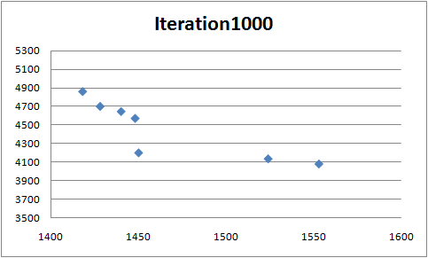
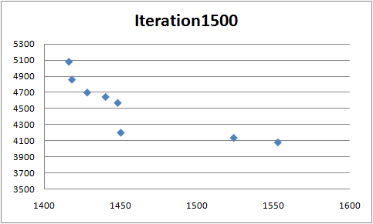
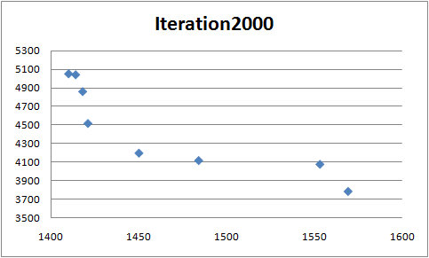
Experimental Results
Movement behavior of a swarm in MOPSO
LA27 (20 jobs 10 machines)
Notes:
This graph show the movement of particles in the swarm.
You can see that as the search process after iterations, the particle discover the solutions toward a Pareto front.

Slide 46
Experimental Results
Results from MOPSO are compared to those obtained from SPEA and CMOEA
SPEA: Strength Pareto Evolutionary Algorithm (Zitzler and Thiele, 1999)
CMOEA: Crowding-Measure-Based Multi-Objective Evolutionary Algorithm (Lei and Wu, 2002)
Notes:
The results from MOPSO algorithm is compare to SPEA and CMOEA,
SPEA uses the dominance criterion for the fitness assignment and selection of solutions
CMOEA makes use of the crowding measure to adjust the external population and assign different fitness for individuals based on that CD value.

Slide 47
Experimental results
Comparison of objective function of solutions from MOPSO with SPEA and CMOEA
Instance | SPEA | CMOEA | MOPSO
FT06 | (58,4) (60,1) (62,0) | (58,4) (60,1) (62,0) | (58,4) (60,1) (62,0) (55,28) (56,27)
FT10 | (1059,180) (1076,196) (1093,267) | (1057,274) (1072,187) (1085,156) | (1057,167) (966,843) (969,725) (1090,234) (1286,116)
FT20 | (1269,6629) (1276,6928) (1287,6376) | (1283,6858) (1287,6668) (1306,6644) | (1234,8502) (1246,8211) (1258,7981) (1271,7776) (1304,7374) (1310,7304) (1333,7089) (1454,6796)
ABZ5 | (1306,439) (1316,486) | (1277,422) (1296,360) | (1284,350) (1270,460.5) (1276,436) (1317,200) (1331,133) (1337,0)
Instance | SPEA | CMOEA | MOPSO
ABZ6 | (981,212) (994,216) (1002,166) | (979,348) (988,155) (993,309) | (978,301) (984,251) (994,196) (1028,62.5) (1054,43) (1084,30) (1088,1.5) (1025,0)
LA26 | (1405,4436) (1428,4336) | (1366,3539) (1375,3537) (1394,4063) | (1333,5259) (1345,5245) (1346,4620) (1349,4392) (1375,4323) (1389,4205) (1676,3551)
LA27 | (1451,2960.5) (1452,2512.5) | (1451,2968.5) (1452,2611.5) | (1386,4736.5) (1389,4458.5) (1401,4197.5) (1407,4151.5) (1416,3974.5) (1434,3756.5) (1483,3739.5) (1508,3662.5)
LA28 | (1400,3111) (1414,2926 | (1398,3553) (1410,3339) | (1358,4825) (1359,4785) (1362,4773) (1369,4158) (1379,4088) (1386,4019) (1393,3501) (1599,3311)
Notes:
This table shows the comparison result of MOPSO with SPEA and CMOEA
MOPSO is able to generate a large set of non-dominated solutions.
And it clearly demonstrate outstanding results compare to SPEA and CMOEA in instance ABZ5 and ABZ6

Slide 49

Experimental Results
Use Č metric to measure the fraction of solutions of B that are dominated by solutions of A
Instance | Č(P,S) | Č(S,P) | Č(P,C) | Č(C,P)
FT06 | 0 | 0 | 0 | 0
FT10 | 0.667 | 0 | 0.333 | 0.2
FT20 | 0 | 0.5 | 0 | 0.375
ABZ5 | 1 | 0 | 0.5 | 0
ABZ6 | 0.333 | 0.125 | 0.667 | 0.125
LA26 | 1 | 0 | 0.428 | 0
LA27 | 0 | 0.25 | 0 | 0.25
LA28 | 0 | 0.125 | 1 | 0
P : MOPSO
S : SPEA
C: CMOEA
Notes:
For the ease of comparison, in this study, we use C metric to evaluate the performance of the proposed algorithm.
So the notation C(A,B) is to measure the ratio of solutions in B which are dominated by solution in A, so the less value of C means that the solutions has a high quality because there are dominated only little… if the value of C =0 mean that there are no solution to be dominated, and on the other hand , if the C =1 mean that all solutions are dominated
So you can see form the table that MOPSO outperform SPEA and CMOEA in most case...
MOPSO obtain lower C metric on 6 out of 8 instances and the different value of C between MOPSO and other two method are significant
But SPEA and CMOEA is slightly outperform MOPSO on two intances, and the difference on C is little

Slide 50
Software Library
ET-Lib
Object Library for Evolutionary Techniques
Available as DLL library
Object Oriented
Include
GLNPSO
Adaptive GLNPSO
DE
DE with Grouping and Strategy Switching
MOPSO
MODE

Slide 51
Library Structure for ETLib
Application Specific
Method Specific
PSO
Problem Specific
Representation
Read Input data
0. Initialize Swarm
Encoding
1. Move Particles
Constraints Checking
Decoding
2. Update velocity & Parameters
Evaluate Fitness
3. Repeat 1 & 2 until stopping criterion is met
Display Results

Slide 52
For More Information
Email: voratas@ait.ac.th
List of references can be found on
http://www.citeulike.org/user/satarov/publications
Contributors:
T. J. Ai
Su Nguyen
Chompoonoot Kasemset
Natanaree Sooksekson
Warisa Wisittivanich
Manavit Vinaipanich
Siriwan Sitthitham
Pandhapon Sombuntham
Thongchai Pratchayaborirak

Slide 53
Reference
Nguyen, S. and Kachitvichyanukul, V. Movement strategies for multi-objective Particle Swarm Optimization, International Journal of Applied Metaheuristic Computing, 1(3), 59-79, July-September 2010
Wisittipanich, W. and Kachitvichyanukul, V. Mutation Strategies toward Pareto Front for Multi-objective Differential Evolution Algorithm, International Journal of Operational Research, article in press.

Slide 54
Notes
References can be found at
http://www.citeulike.org/user/satarov/publications
Email: voratas@ait.ac.th
Some of the materials was used in short courses at:
Sichuan University, China
Shanghai Maritime University, China
Chung Hua University, Taiwan
Chung Yuan Christian University, Taiwan
Tunghai University, Taiwan

Slide 55
Differential Evolution

Slide 56
START
Generate initial population
Evaluate fitness values
For each target vector
Generate trail vector, Evaluate fitness of trail vector, Select the better vector between, target vector and trail vector, Update global best vector
No
Time to stop
Yes
END
Notes:
นี่ก็เป็น flowchart ของ DE algorithm
คล้ายๆ กับ PSO
แต่ละจุดจะมีการ generate new corresponding solution หรือเรียกว่า trial vector โดย mutation &crossover
จากนั้น new solution จะภูก evaluate objective value และนำมาเปรียนเทียบกับจุดเดิม เพื่อทำการ selection จุดที่ดีกว่า
Process นี้จะถูกกระทำวนไปจนกว่า จะถึงเงือนไขที่จะให้หยุด

Slide 57
Differential Evolution (DE)
N population vectors
X_{i,g}
F * (x_{j,r2,g} – x_{j,r3,g} )
V_{i,g} : Mutant vector
X_{i,g} : Target vectors
X_{r3,g}
X_{r2,g}
X_{r1,g}
V_{j,i,g} = x_{j,r1,g} + F * (x_{j,r2,g} – x_{j,r3,g} )
Combine randomly selected vectors to produce mutant vector

Slide 58
Differential Evolution (DE)
Z_{i,g}
N population vectors : X_{i,g}
X_{i,g}
V_{i,g} : Mutant vector
X_{i,g} : Target vectors
Z_{i,g} : Trial vector
Crossover of target vector with mutant vector produces trial vector
There are two popular crossover methods in DE, binomial and exponential

Slide 59
Differential Evolution (DE)
Z_{i,g}
N population vectors : X_{i,g}
V_{i,g} : Mutant vector
Z_{i,g} : Trial vector
Trial vector replaces target vector if its fitness is better than that of the target vector

Slide 60
Differential Evolution (DE)
Z_{i,g}
N population vectors : X_{i,g}
V_{i,g} : Mutant vector
Z_{i,g} : Trial vector
Target vector remains if its fitness is better than that of the trail vector

Slide 61
Binomial Crossover
j_{u}
Dim. J^{th} 1 2 3 4 5 6
Mutant vector, V_{i,g}
r₅≤C_{r}
Start
r₃≤C_{r}
Trial vector, Z_{i,g}
r₄>C_{r}
r₁>C_{r}
r₂>C_{r}
Target vector, X_{i,g}

Slide 62
Exponential Crossover
j_{u}
Dim. J^{th} 1 2 3 4 5 6
Mutant vector, V_{i,g}
Start
r₁≤C_{r}
r₂≤C_{r}
Trial vector, Z_{i,g}
r₃>C_{r}
Target vector, X_{i,g}

Slide 63
Differential Evolution (DE)
Notation “DE / a / b / c ”
DE : Differential Evolution
a : the type of vector to be perturbed which can be “rand” or “ best”
b : the number of different vectors used for perturbation of x
c : the type of crossover being used
(bin: binomial , exp: exponential)
DE/ rand/ 1/ bin
DE/ rand/ 2/ exp
DE/ best/ 1/ bin

Slide 64
Parameters (DE)
Population size N
Number of iteration
The factor F
Crossover method/probability

Slide 65
Computational Experiment
Objective : Minimize makespan
Test Instance
FT20, LA01, LA21, LA29, LA35, LA37
Parameter Setting
Compared to 1ST-PSO version of the previous research (2ST-PSO, Pratchayaborirak and Kachitvichyanukul 2007)
Both 1ST-DE and 1ST-PSO implement the same encoding and decoding schemes
Parameter | Value
Population Size, N | 100
F | 0.5 , 1 , 1.5 , 2
C_{r} | 0.2
Number of iterations | 500
Notes:
In the experiment, The objective is to minimize makespan. We select 6 benchmark instance representing different problem sizes.
Parameters used in this experiment are shown in this table; In this study, we particularly compare 1ST-DE to with 1ST-PSO which has the same algorithm as in previous PSO studies (by Pratchayaborirak and Kachitvichyanukul 2007), And for the fair comparison, for both algorithms, we use the same encoding and decoding scheme, population size and number of iterations.

Slide 66
Experimental Results: Makespan
Problem | Size | 1ST-PSO |  |  |  | 1ST-DE |  |  |  | P Value
 |  | Fitness Value |  |  | Time | Fitness Value |  |  | Time
 |  | Best | Avg. | SD | Sec. | Best | Avg. | SD | Sec.
FT20 | 10x10 | 1226 | 1279.9 | 29.52 | 12.82 | 1224 | 1255 | 19.69 | 6.88 | 0.042
LA01 | 5x10 | 666 | 666 | 0 | 4.85 | 666 | 666 | 0 | 2.44 | 1
LA21 | 15x10 | 1159 | 1167.4 | 6.50 | 20.36 | 1126 | 1141.1 | 9.54 | 8.35 | 0.000
LA29 | 20x10 | 1319 | 1335.4 | 9.49 | 29.91 | 1277 | 1300.7 | 13.33 | 13.86 | 0.000
LA35 | 30x10 | 1939 | 1967.6 | 20.73 | 58.03 | 1899 | 1917 | 12.89 | 26.52 | 0.000
LA37 | 15x15 | 1514 | 1545.4 | 16.44 | 28.52 | 1485 | 1515.8 | 20.37 | 14.76 | 0.002
Notes:
This table show experimental results of 1ST-PSO and 1ST-DE run on the same personal computer, The first column is the instance, the next column is problem size. For each algorithm, the best, average, standard deviations of makespan, and computing time from 10 runs are illustrated.
According to the results, it is observed that all of solutions obtained from the proposed DE are better than or equal to results obtained from 1ST-PSO with relatively faster computing time. The statistical t-test with 95% confident interval was also performed and the result indicate that 1ST-DE outperforms 1ST-PSO in most cases.

Slide 67
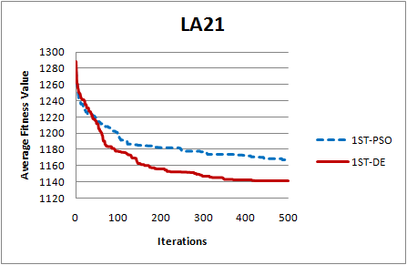
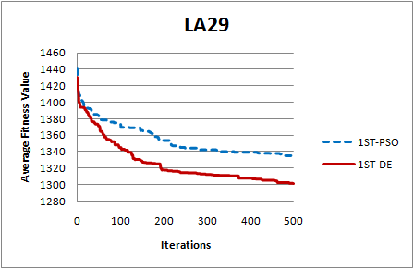
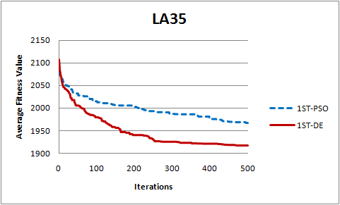
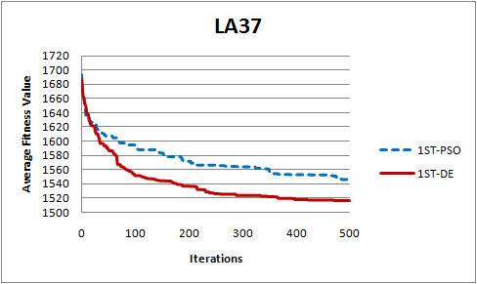
Experimental Results: Convergence graph
Notes:
We also observe the convergence behavior of the proposed algorithm. The blue dot line represents PSO and the red line represents DE. From this figure, we can easily see that 1ST-DE demonstrates faster convergence than 1ST-PSO.

Slide 68
Parameters (PSO)
Population size N
Number of iteration
Inertia Weight
Acceleration constant for Social Learning
Acceleration constant for Cognitive Learning
Additional constants may be required if more leaning terms are included, e.g., PSO with multiple social learning terms GLNPSO requires two more acceleration constants

Slide 69

Particle Swarm Optimization (PSO) Algorithm
Movement strategies only focus on this term
Position:
Velocity:

Slide 70
Further Research
Differential Evolution
Job shop scheduling
Flexible job shop scheduling
Generalize vehicle routing with multiple requests
Multimode resource constrained project scheduling
Location-allocation
Location-routing

